Slide 1
Regression: Contact Session 4
Dr. Chetana Gavankar, Ph.D,
IIT Bombay-Monash University Australia
Chetana.gavankar@pilani.bits-pilani.ac.in

Slide 2
Contact Session 4
Date – 26/04/2020
Time – 10am to 12pm

Slide 3
Topics to be covered
Module 4: Building Multiple Linear Regression Models
Building multiple linear regression model by solving normal equations
Building multiple linear regression model by gradient descent algorithms
Performance measure for multiple linear regression models
Feature selection algorithms for multiple linear regression models
Forward and backward feature selection algorithms for multiple linear regression models

Slide 4
Building multiple linear regression model by solving normal equations

Slide 5
Multiple Linear Regression
y= w₀+w₁x₁+w₂x₂+…w_{D}x_{D}
( x⁽¹⁾y₁, x⁽²⁾y₂,…………. x^{(n)}y_{n})
x⁽¹⁾ = (x₁₁,x₁₂,….x_{1D})

Slide 6
Real life examples
If E-commerce Company has collected the data of its customers such as Age, purchased history of a customer, gender and company want to find the relationship between these different dependents and independent variables.
A gym trainer has collected the data of his client that are coming to his gym and want to observe some things of client that are health, eating habits (which kind of product client is consuming every week), the weight of the client. This wants to find a relation between these variables.

Slide 7
Real life examples
Demand forecasting: it can be used to predict demand for goods and services. For instance restaurant chains can prepare predicted type and quantity of food that customers will consume based on weather type, day of the week, time of the day, reservation volumes.
In medical filed a regression model can be used to analyze the effect of purposed radiation treatment on reducing tumor size, input variables may be like duration of a single radiation treatment frequency of radiation treatment, patient attribute such as height, weight, age.

Slide 8
Real life example
You can see prices of grains in agricultural markets vary every day. You may imagine that it's daily price(Yt) fluctuations depend on last day's temperature(Tt-1), last day's humidity(Ht-1), last day's sold out stock(St-1), last day's market arrivals(At-1), last day's price of substitute commodity(Ct-1) etc.
Yt = w0 + w1*Tt-1 + w2*Ht-1 + w3*St-1 + w4*At-1 + w5*Ct-1
You can use least square method to reduce error in the equation and can estimate Yt that is price of grain at time point t.

Slide 9
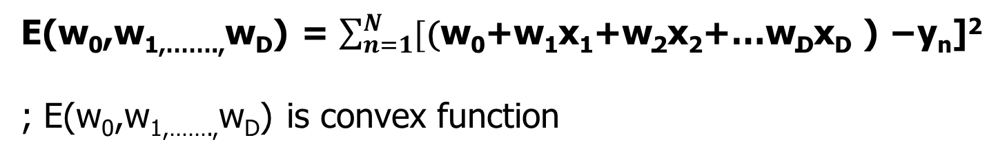
Multiple Linear Regression
y= w₀+w₁x₁+w₂x₂+…w_{D}x_{D}
(x⁽¹⁾y₁, x⁽²⁾y₂,…………. x^{(n)}y_{n})
x^{(n)} = (x_{n1},x_{n2},….x_{nD})
E(w₀,w_{1,…….,}w_{D}) = $\sum_{n=1}^{N}{[\text{(}\text{w}\text{0}\text{+}\text{w}\text{1}\text{x}\text{1}\text{+}\text{w}\text{2}\text{x}\text{2}\text{+…}\text{wDxD} \text{) −}\text{y}\text{n}\text{]}\text{2 }}$
; E(w₀,w_{1,…….,}w_{D}) is convex function

Slide 10
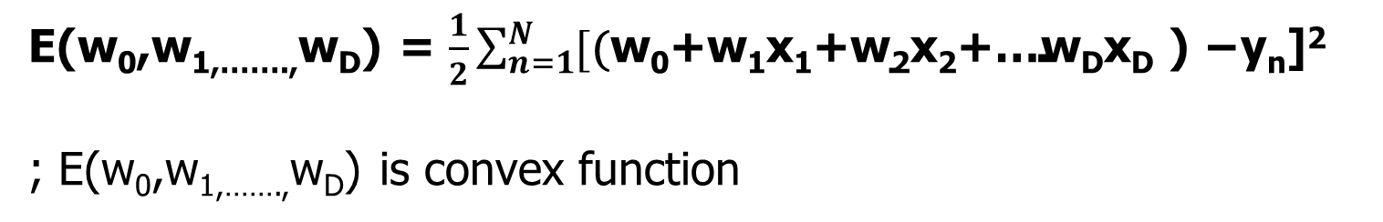
Sum of squared error
E(w₀,w_{1,…….,}w_{D}) = $\frac{1}{2}\sum_{n=1}^{N}{[\text{(}\text{w}\text{0}\text{+}\text{w}\text{1}\text{x}\text{1}\text{+}\text{w}\text{2}\text{x}\text{2}\text{+}\text{…}\text{wDxD} \text{) }\text{−}\text{y}\text{n}\text{]}\text{2 }}$
; E(w₀,w_{1,…….,}w_{D}) is convex function

Slide 11
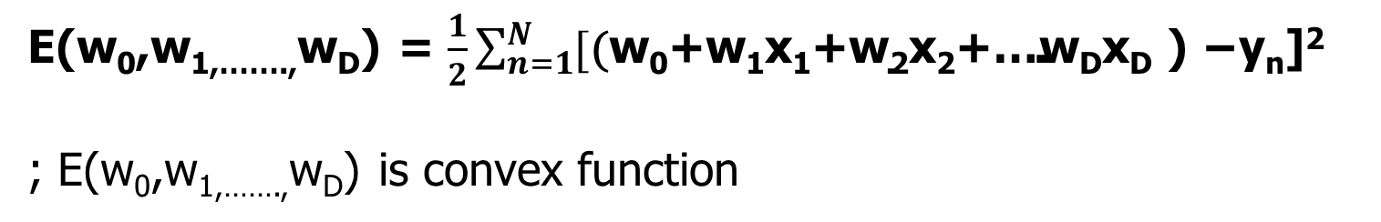
Multiple Linear Regression
E(w₀,w_{1,…….,}w_{D}) = $\frac{1}{2}\sum_{n=1}^{N}{[\text{(}\text{w}\text{0}\text{+}\text{w}\text{1}\text{x}\text{1}\text{+}\text{w}\text{2}\text{x}\text{2}\text{+…}\text{wDxD} \text{) −}\text{y}\text{n}\text{]}\text{2 }}$
; E(w₀,w_{1,…….,}w_{D}) is convex function
This linear equation with D+1 variables
We get D+1 such simultaneous equations with of D+1 variables

Slide 12
Multiple Linear Regression

Slide 13
Multiple Linear Regression

Slide 14
Building multiple linear regression model by gradient descent algorithms

Slide 15
Multiple Linear Regression: Gradient Descent Algorithm

Slide 16
Multiple Linear Regression :
Calculating Gradient

Slide 17
Multiple Linear Regression

Slide 18
Multiple Linear Regression: Stochastic Gradient Descent Algorithm

Slide 19
Multiple Linear Regression: Mini-batch Gradient Descent Algorithm

Slide 20
Multiple Linear Regression: Mini-batch Gradient Descent Algorithm

Slide 21
Performance measure for multiple linear regression models

Slide 22
Multiple Linear Regression
y^{(n)}= w₀+w₁x_{n1}+w₂x_{n2}+…w_{nD}x_{nD} + ϵ_{n}
( x⁽¹⁾y⁽¹⁾, x⁽²⁾y⁽²⁾,…………. x^{(n)}y^{(n)})
x⁽¹⁾ = (x₁₁,x₁₂,….x_{1D})

Slide 23
Multiple Linear Regression
F-statistic - at least one attributes from D attributes are non-zero
y^{(n)}= w₀+w₁x_{n1}+w₂x_{n2}+…w_{nD}x_{nD} + ϵ_{n ;} ϵ = N (0,σ²)
Null Hypothesis H₀: w₀ = w_{1= ,…….,}w_{D} = 0
Alternate Hypothesis H₁ : atleast one w_{k} is non zero
N=number of examples
D=number of features
Degrees of freedom of F-statistics – D, N-D-1
F-statistic
restricted total sum of squares
Unrestricted residual sum of squares
Unlike t-tests that can assess only one regression coefficient at a time, the F-test can assess multiple coefficients simultaneously.
A low p-value (< 0.05) for F-statistic indicates that you can reject the null hypothesis indicating there is relation between some input feature x and output y

Slide 24
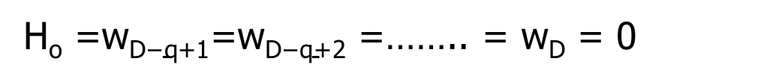
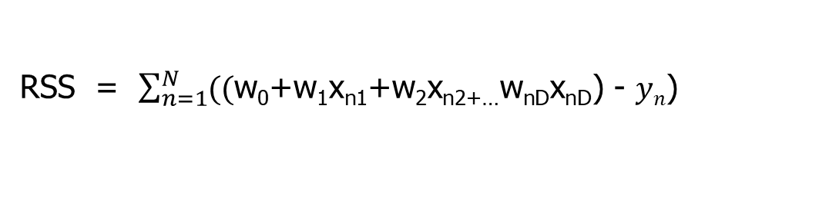
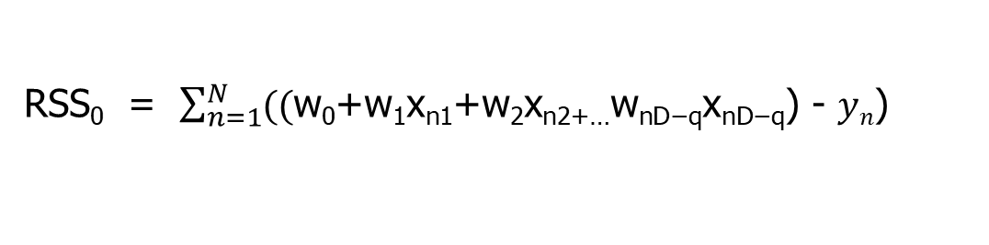
Multiple Linear Regression:
Some attributes q out of D are non-zero
H_{o} =$\text{w}\text{D}\text{−}\text{q}\text{+1}$=$\text{w}\text{D}\text{−}\text{q}\text{+}$₂ =…….. = $\text{w}\text{D}$ = 0
H_{a} = atleast one of $\text{w}\text{D}\text{−}\text{q}\text{+1, }\text{w}\text{D}\text{−}\text{q}\text{+}$₂ ,……..$\text{w}\text{D}$ is not 0
RSS₀ = $\sum_{n=1}^{N}{((\text{w}\text{0}\text{+}\text{w}\text{1}\text{x}\text{n}\text{1}\text{+}\text{w}\text{2}\text{x}\text{n}\text{2+…}\text{w}\text{n}\text{D}\text{−}\text{qxnD}\text{−}\text{q}\text{)}\text{ - }yn\text{)}}$
RSS = $\sum_{n=1}^{N}{((\text{w}\text{0}\text{+}\text{w}\text{1}\text{x}\text{n}\text{1}\text{+}\text{w}\text{2}\text{x}\text{n}\text{2+…}\text{w}\text{n}\text{D}\text{x}\text{nD}\text{)}\text{ - }yn\text{)}}$

Slide 25
Feature selection algorithms for multiple linear regression models

Slide 26
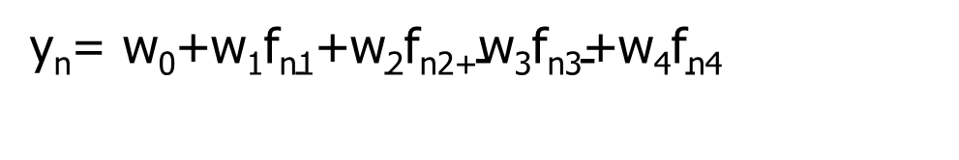
Multiple Features
y_{n}= $\text{w}\text{0}\text{+}\text{w}\text{1}\text{f}\text{n}\text{1}\text{+}\text{w}\text{2}\text{f}\text{n}\text{2+}\text{w}\text{3}\text{f}\text{n}\text{3}\text{+}\text{w}\text{4}\text{f}\text{n}\text{4}$
Size (feet²) f1 | Number of bedrooms f2 | Number of floors f3 | Age of home (years) f4 | Price ($1000) y
2104 | 5 | 1 | 45 | 460
1416 | 3 | 2 | 40 | 232
1534 | 3 | 2 | 30 | 315
852 | 2 | 1 | 36 | 178
… | … | … | … | …

Slide 27
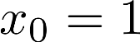
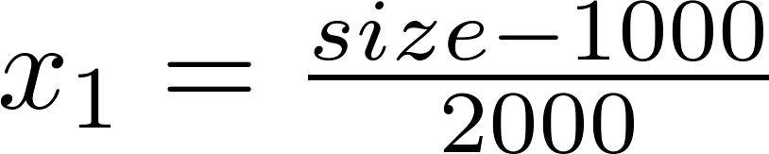
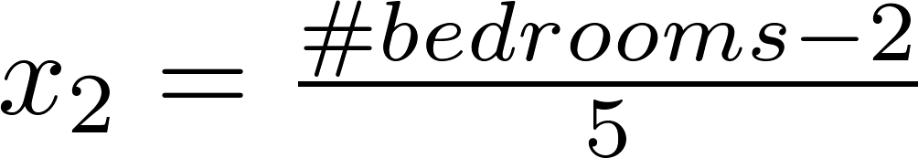
Feature scaling
Feature scaling of features x_{i} consists of rescaling the range of features to scale the range in [0, 1] or [−1, 1] (Do not apply to )
Average value of x1
E.g.
Maximum value of x1 – min value of x1

Slide 28
Best Subset Selection
Training Dataset – 2/3rd of Data Set, Testing Dataset – 1/3rd of Data Set
Example input N= 3000, Training Dataset=2000, Testing Dataset – 1000

Slide 29
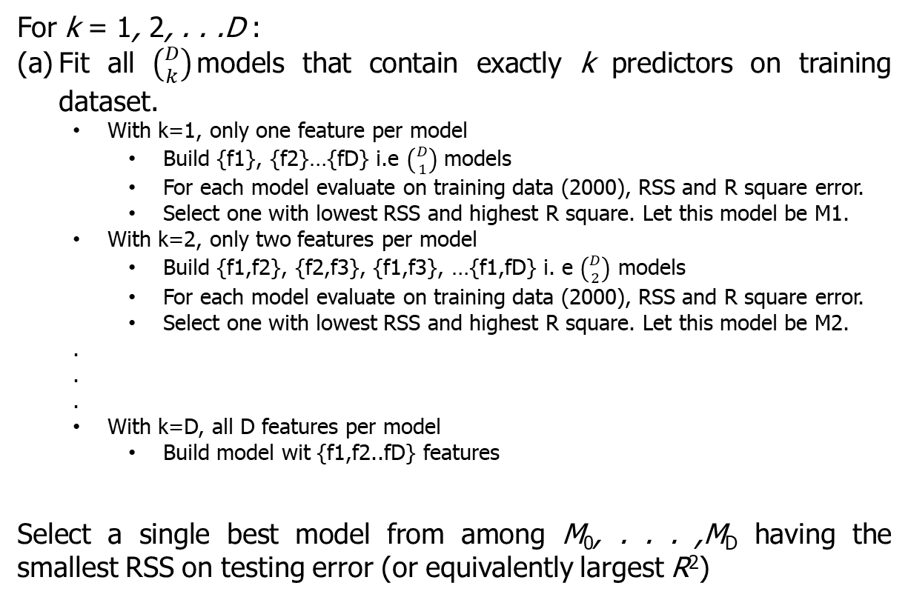
Best Subset Selection
For k = 1, 2, . . .D :
Fit all $\left({D \atop k}\right)$models that contain exactly k predictors on training dataset.
With k=1, only one feature per model
Build {f1}, {f2}…{fD} i.e $\left({D \atop 1}\right)$ models
For each model evaluate on training data (2000), RSS and R square error.
Select one with lowest RSS and highest R square. Let this model be M1.
With k=2, only two features per model
Build {f1,f2}, {f2,f3}, {f1,f3}, …{f1,fD} i. e $\left({D \atop 2}\right)$ models
For each model evaluate on training data (2000), RSS and R square error.
Select one with lowest RSS and highest R square. Let this model be M2.
.
.
.
With k=D, all D features per model
Build model wit {f1,f2..fD} features
Select a single best model from among M₀, . . . ,M_{D} having the smallest RSS on testing error (or equivalently largest R²)

Slide 30
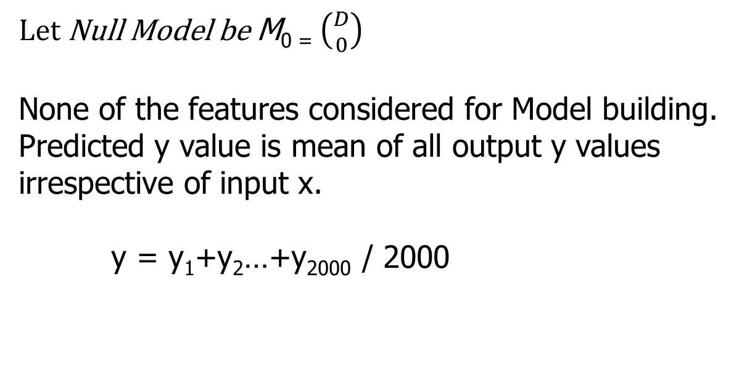
Null Model
Let Null Model be M₀ ₌ $\left({D \atop 0}\right)$
None of the features considered for Model building.
Predicted y value is mean of all output y values irrespective of input x.
y = y₁+y₂…+y₂₀₀₀ / 2000

Slide 31
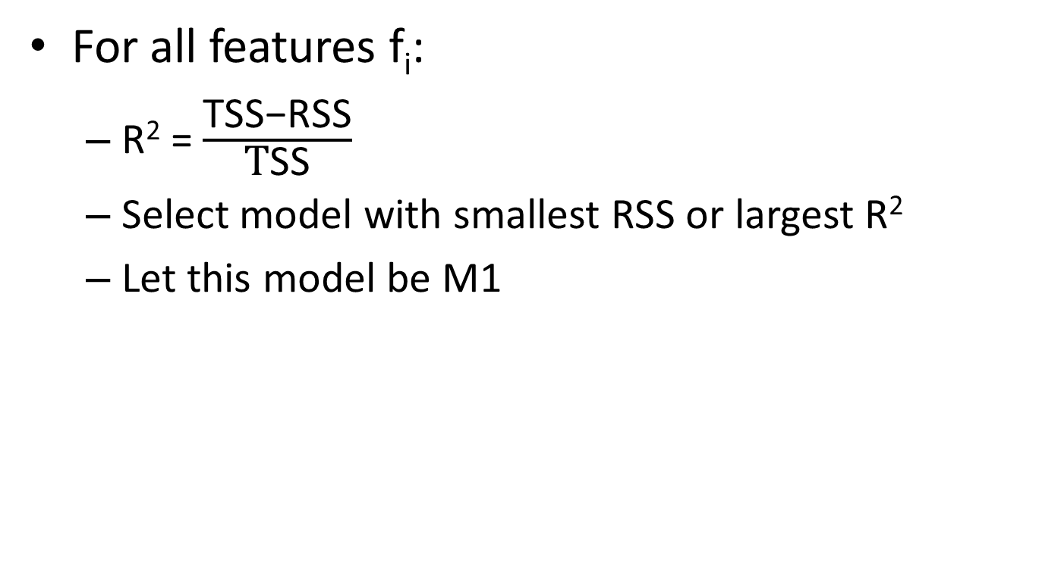
Models with one feature
For all features f_{i}:
R² = $\frac{\text{TSS}\text{−}\text{RSS}}{\text{T}\text{SS}}$
Select model with smallest RSS or largest R²
Let this model be M1

Slide 32
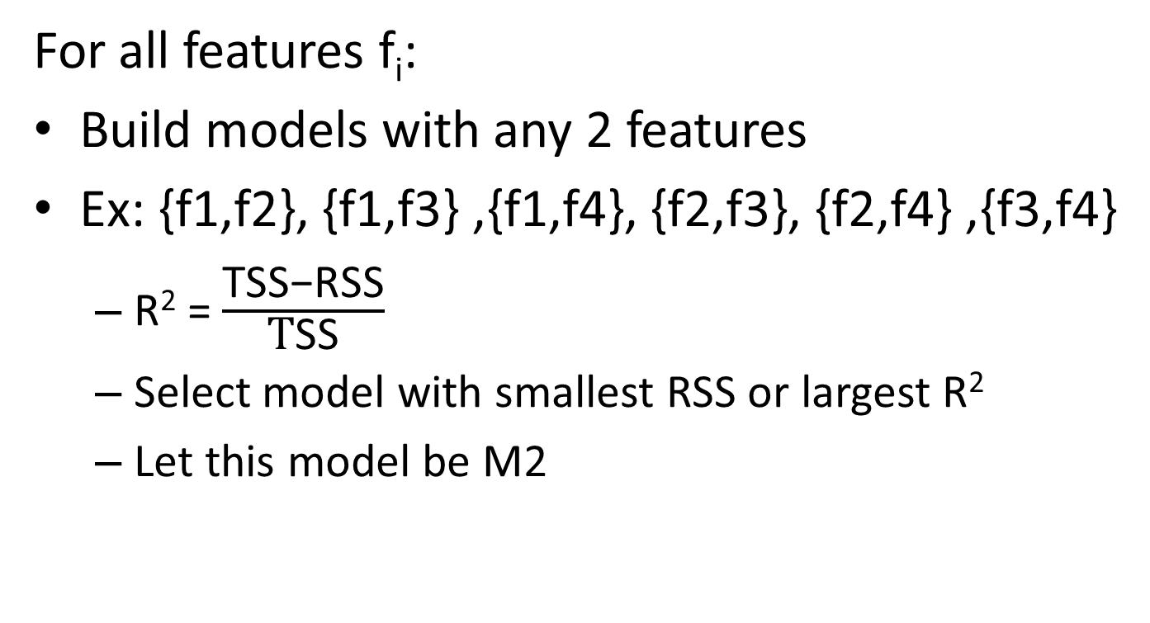
Models with two features
For all features f_{i}:
Build models with any 2 features
Ex: {f1,f2}, {f1,f3} ,{f1,f4}, {f2,f3}, {f2,f4} ,{f3,f4}
R² = $\frac{\text{TSS}\text{−}\text{RSS}}{\text{T}\text{SS}}$
Select model with smallest RSS or largest R²
Let this model be M2

Slide 33
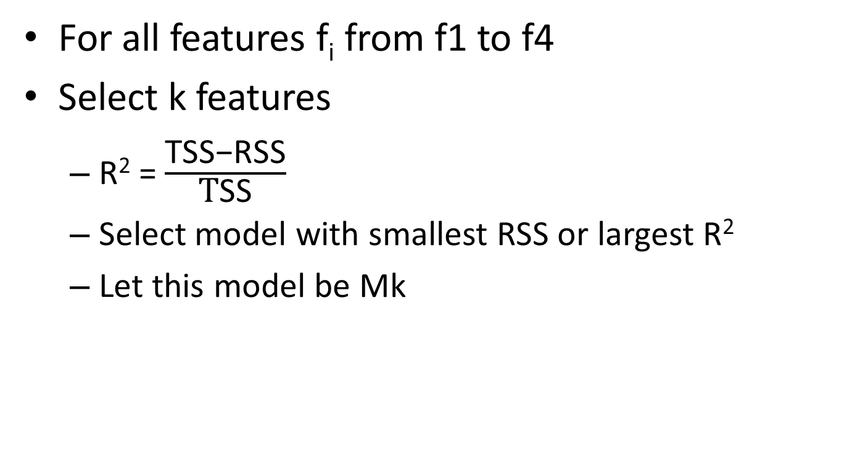
Models with k features
For all features f_{i} from f1 to f4
Select k features
R² = $\frac{\text{TSS}\text{−}\text{RSS}}{\text{T}\text{SS}}$
Select model with smallest RSS or largest R²
Let this model be Mk

Slide 34
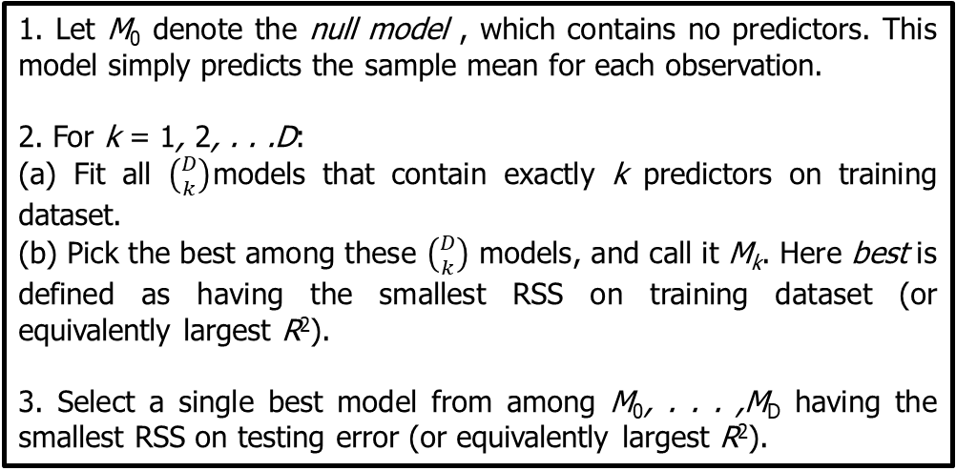
Best Subset Selection
Training Dataset – 2/3rd of Data Set, Testing Dataset – 1/3rd of Data Set
1. Let M₀ denote the null model , which contains no predictors. This model simply predicts the sample mean for each observation.
2. For k = 1, 2, . . .D:
(a) Fit all $\left({D \atop k}\right)$models that contain exactly k predictors on training dataset.
(b) Pick the best among these $\left({D \atop k}\right)$ models, and call it M_{k}. Here best is defined as having the smallest RSS on training dataset (or equivalently largest R²).
3. Select a single best model from among M₀, . . . ,M_{D} having the smallest RSS on testing error (or equivalently largest R²).

Slide 35
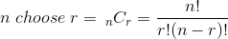
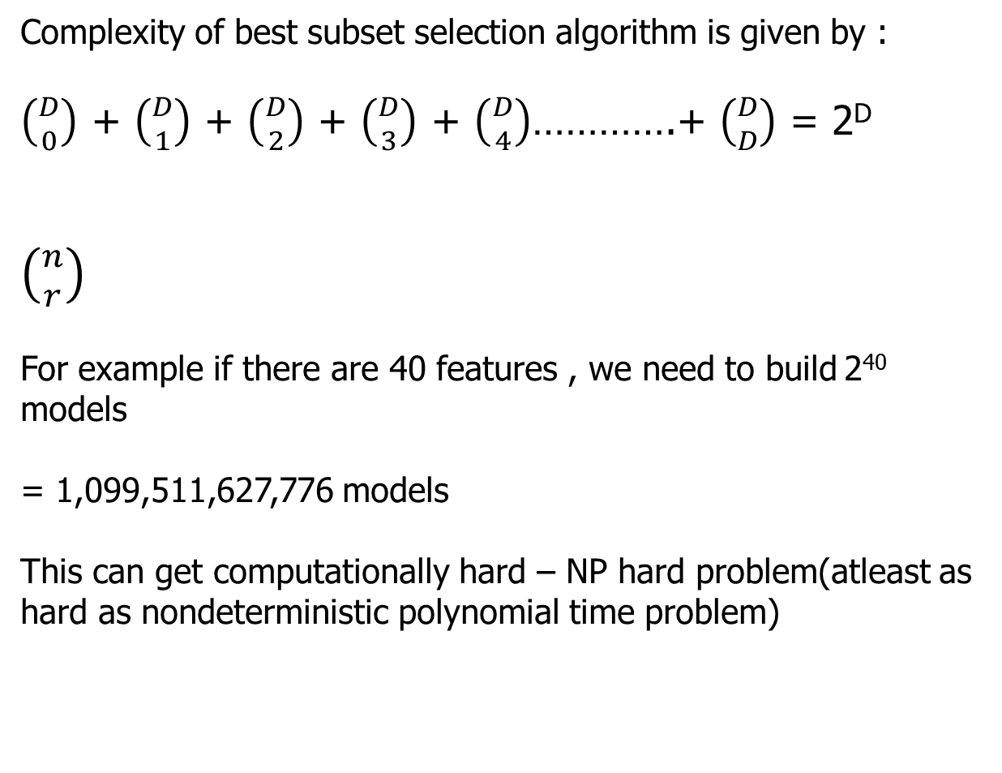
Best Subset Selection computations
Complexity of best subset selection algorithm is given by :
$\left({D \atop 0}\right)$ + $\left({D \atop 1}\right)$ + $\left({D \atop 2}\right)$ + $\left({D \atop 3}\right)$ + $\left({D \atop 4}\right)$………….+ $\left({D \atop D}\right)$ = 2^{D}
$\left({n \atop r}\right)$
For example if there are 40 features , we need to build 2⁴⁰ models
= 1,099,511,627,776‬ models
This can get computationally hard – NP hard problem(atleast as hard as nondeterministic polynomial time problem)

Slide 36
Forward and backward feature selection algorithms for multiple linear regression models

Slide 37
Forward stepwise Selection
Training Dataset – 2/3rd of Data Set, Testing Dataset – 1/3rd of Data Set
Example input N= 3000, Training Dataset=2000, Testing Dataset – 1000

Slide 38
Multiple Features
y_{n}= $\text{w}\text{0}\text{+}\text{w}\text{1}\text{f}\text{n}\text{1}\text{+}\text{w}\text{2}\text{f}\text{n}\text{2+}\text{w}\text{3}\text{f}\text{n}\text{3}\text{+}\text{w}\text{4}\text{f}\text{n}\text{4}$
Size (feet²) f1 | Number of bedrooms f2 | Number of floors f3 | Age of home (years) f4 | Price ($1000) y
2104 | 5 | 1 | 45 | 460
1416 | 3 | 2 | 40 | 232
1534 | 3 | 2 | 30 | 315
852 | 2 | 1 | 36 | 178
… | … | … | … | …

Slide 39
Forward stepwise Selection
Training Dataset – 2/3rd of Data Set, Testing Dataset – 1/3rd of Data Set
1. Let M₀ denote the null model , which contains no predictors.
This model simply predicts the sample mean for each observation.
2. For k = 0, 1, 2, . . .D-1:
(a) Consider all D − k models that augment the predictors in M_{k} with one additional predictor.
(b) Choose the best among these D − k models, and call it M_{k+1}.
Here best is defined as having smallest RSS on training dataset (or highest R²).
3. Select a single best model from among M₀, M₁ , . . . , M_{D} having the smallest RSS on testing error (or equivalently largest R²).

Slide 40
Null Model
Let Null Model be M₀ ₌ $\left({D \atop 0}\right)$
None of the features considered for Model building.
Predicted y value is mean of all output y values irrespective of input x.
y = y₁+y₂…+y₂₀₀₀ / 2000

Slide 41
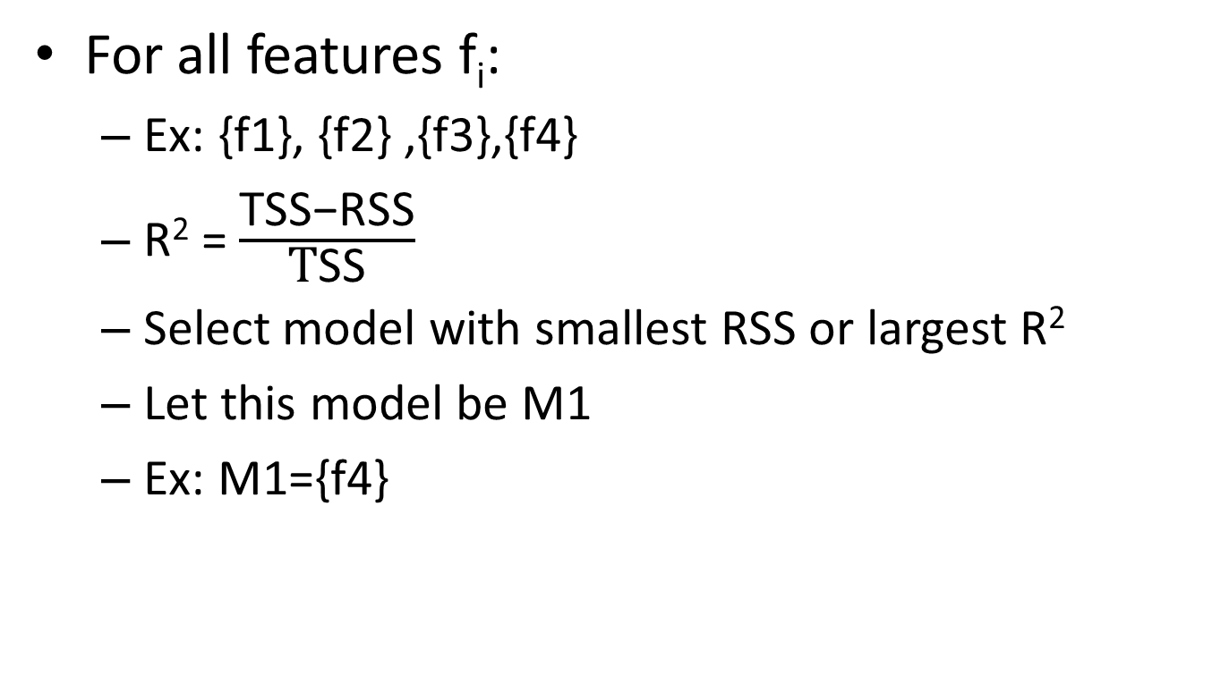
Models with one feature
For all features f_{i}:
Ex: {f1}, {f2} ,{f3},{f4}
R² = $\frac{\text{TSS}\text{−}\text{RSS}}{\text{T}\text{SS}}$
Select model with smallest RSS or largest R²
Let this model be M1
Ex: M1={f4}

Slide 42
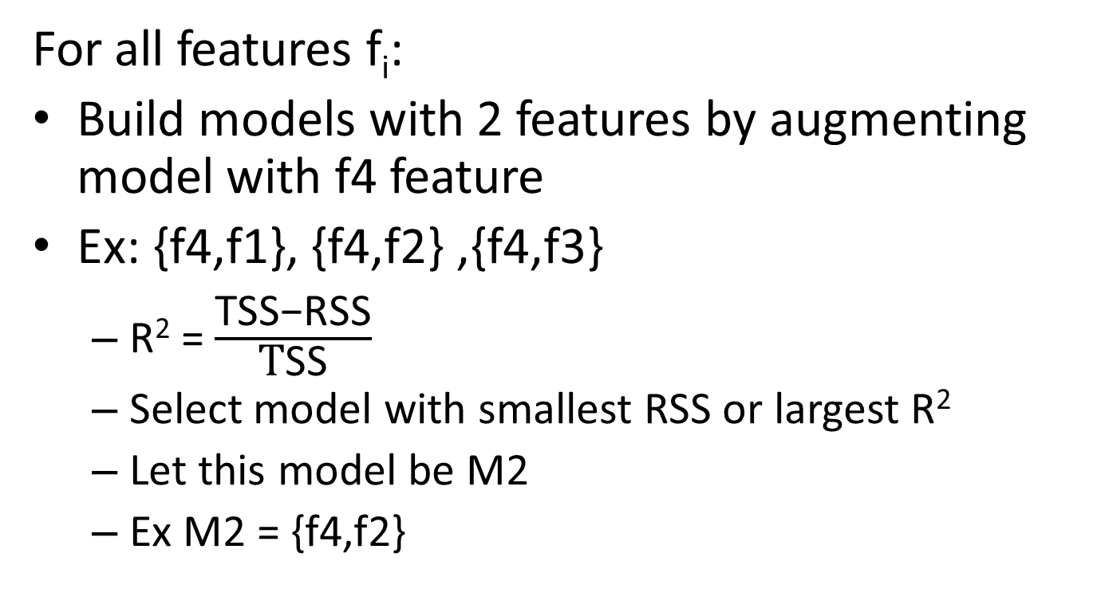
Models with two features
For all features f_{i}:
Build models with 2 features by augmenting model with f4 feature
Ex: {f4,f1}, {f4,f2} ,{f4,f3}
R² = $\frac{\text{TSS}\text{−}\text{RSS}}{\text{T}\text{SS}}$
Select model with smallest RSS or largest R²
Let this model be M2
Ex M2 = {f4,f2}

Slide 43
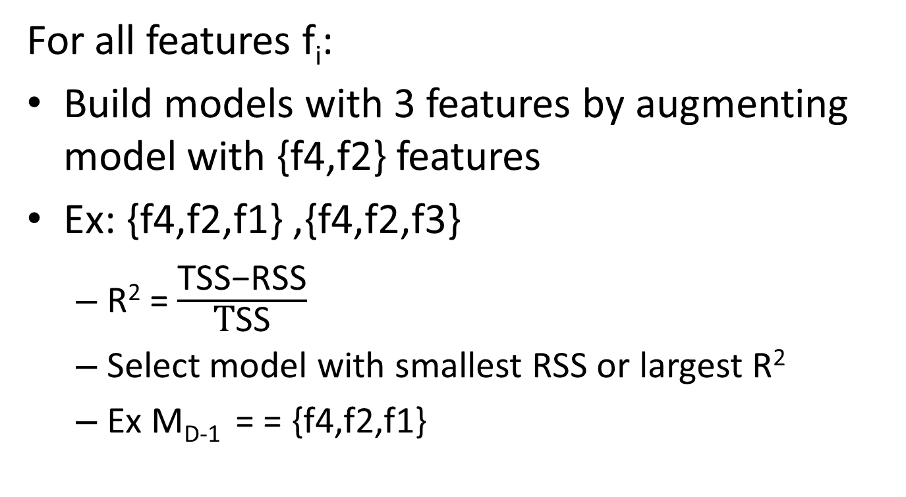
Models with three features
For all features f_{i}:
Build models with 3 features by augmenting model with {f4,f2} features
Ex: {f4,f2,f1} ,{f4,f2,f3}
R² = $\frac{\text{TSS}\text{−}\text{RSS}}{\text{T}\text{SS}}$
Select model with smallest RSS or largest R²
Ex M_{D-1} = = {f4,f2,f1}

Slide 44
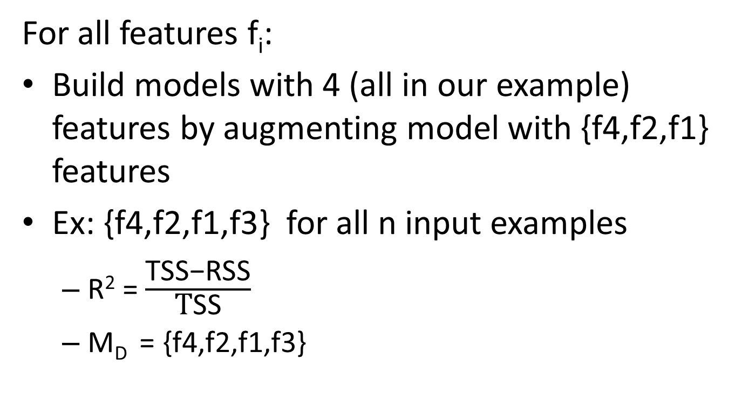
Models with all features
For all features f_{i}:
Build models with 4 (all in our example) features by augmenting model with {f4,f2,f1} features
Ex: {f4,f2,f1,f3} for all n input examples
R² = $\frac{\text{TSS}\text{−}\text{RSS}}{\text{T}\text{SS}}$
M_{D} = {f4,f2,f1,f3}

Slide 45
Forward stepwise Selection
Training Dataset – 2/3rd of Data Set, Testing Dataset – 1/3rd of Data Set
1. Let M₀ denote the null model , which contains no predictors.
This model simply predicts the sample mean for each observation.
2. For k = 0, 1, 2, . . .D-1:
(a) Consider all D − k models that augment the predictors in M_{k} with one additional predictor.
(b) Choose the best among these D − k models, and call it M_{k+1}.
Here best is defined as having smallest RSS on training dataset (or highest R²).
3. Select a single best model from among M₀, M₁ , . . . , M_{D} having the smallest RSS on testing error (or equivalently largest R²).

Slide 46
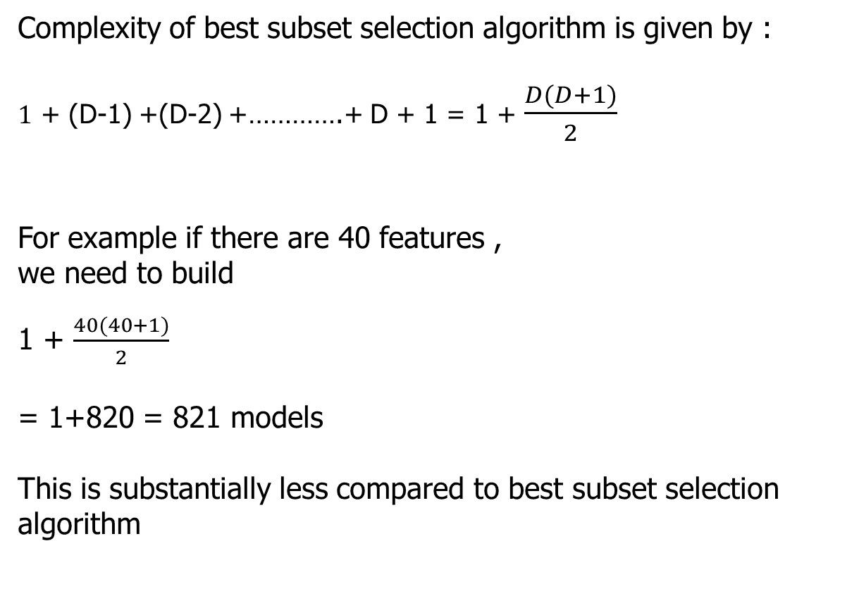
Forward stepwise Selection computations
Complexity of best subset selection algorithm is given by :
$1$ + (D-1) +(D-2) +………….+ D + 1 = 1 + $\frac{D(D+1)}{2}$
For example if there are 40 features ,
we need to build
1 + $\frac{40(40+1)}{2}$
= 1+820 = 821‬ models
This is substantially less compared to best subset selection algorithm

Slide 47
Backward stepwise Selection
Training Dataset – 2/3rd of Data Set, Testing Dataset – 1/3rd of Data Set
1. Let M_{D} denote the full model, which contains all p predictors.
2. For k = D, D − 1, . . . , 1:
(a) Consider all k models that contain all but one of the predictors in M_{k}, for a total of k − 1 predictors.
(b) Choose the best among these k models, and call it M_{k−1}. Here
best is defined as having smallest RSS on training dataset (or highest R²).
3. Select a single best model from among M₀, M₁. . . ,M_{D}having smallest RSS on testing error (or equivalently largest R²).

Slide 48
Multiple Features
y_{n}= $\text{w}\text{0}\text{+}\text{w}\text{1}\text{f}\text{n}\text{1}\text{+}\text{w}\text{2}\text{f}\text{n}\text{2+}\text{w}\text{3}\text{f}\text{n}\text{3}\text{+}\text{w}\text{4}\text{f}\text{n}\text{4}$
Size (feet²) f1 | Number of bedrooms f2 | Number of floors f3 | Age of home (years) f4 | Price ($1000) y
2104 | 5 | 1 | 45 | 460
1416 | 3 | 2 | 40 | 232
1534 | 3 | 2 | 30 | 315
852 | 2 | 1 | 36 | 178
… | … | … | … | …

Slide 49
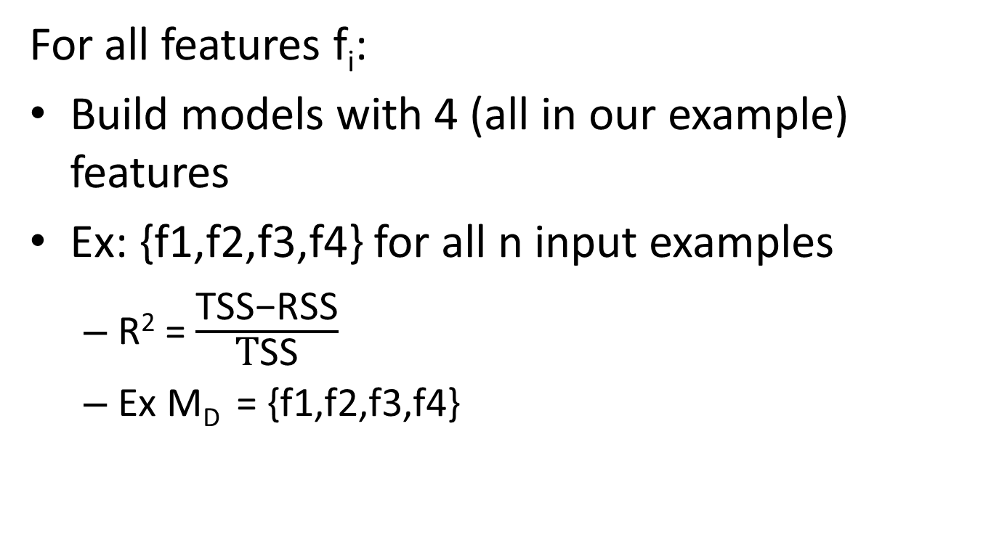
Models with all features
For all features f_{i}:
Build models with 4 (all in our example) features
Ex: {f1,f2,f3,f4} for all n input examples
R² = $\frac{\text{TSS}\text{−}\text{RSS}}{\text{T}\text{SS}}$
Ex M_{D} = {f1,f2,f3,f4}

Slide 50
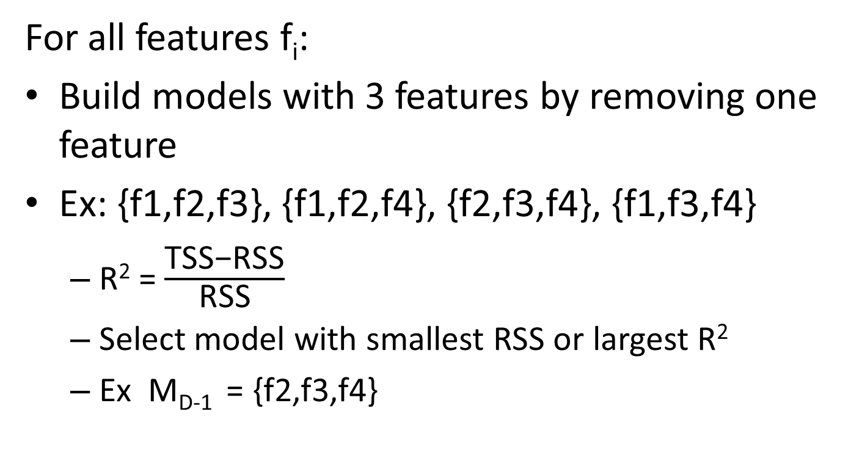
Models with D-1 features
For all features f_{i}:
Build models with 3 features by removing one feature
Ex: {f1,f2,f3}, {f1,f2,f4}, {f2,f3,f4}, {f1,f3,f4}
R² = $\frac{\text{TSS}\text{−}\text{RSS}}{\text{RSS}}$
Select model with smallest RSS or largest R²
Ex M_{D-1} = {f2,f3,f4}

Slide 51
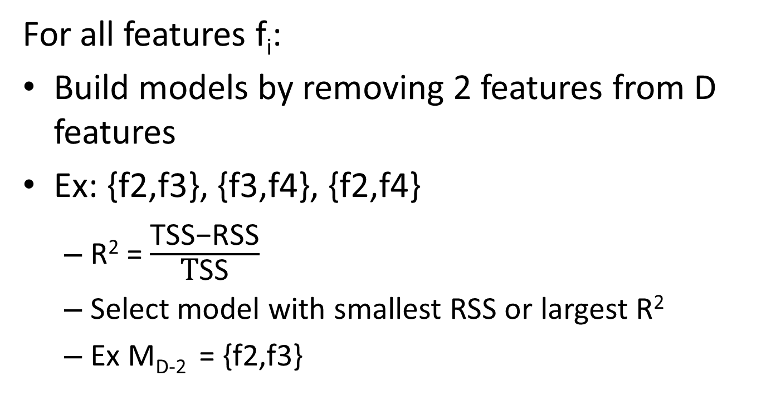
Models with D-2 features
For all features f_{i}:
Build models by removing 2 features from D features
Ex: {f2,f3}, {f3,f4}, {f2,f4}
R² = $\frac{\text{TSS}\text{−}\text{RSS}}{\text{T}\text{SS}}$
Select model with smallest RSS or largest R²
Ex M_{D-2} = {f2,f3}

Slide 52
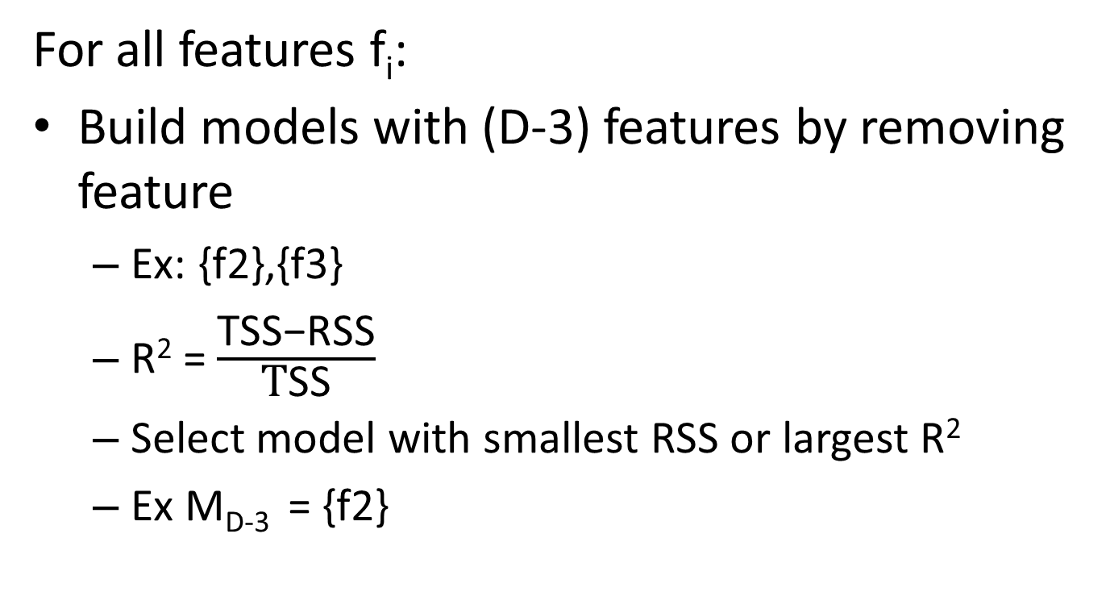
Models with D-3 features
For all features f_{i}:
Build models with (D-3) features by removing feature
Ex: {f2},{f3}
R² = $\frac{\text{TSS}\text{−}\text{RSS}}{\text{T}\text{SS}}$
Select model with smallest RSS or largest R²
Ex M_{D-3} = {f2}

Slide 53
Null Model
Let Null Model be M₀ ₌ $\left({D \atop 0}\right)$
None of the features considered for Model building.
Predicted y value is mean of all output y values irrespective of input x.
y = y₁+y₂…+y₂₀₀₀ / 2000

Slide 54
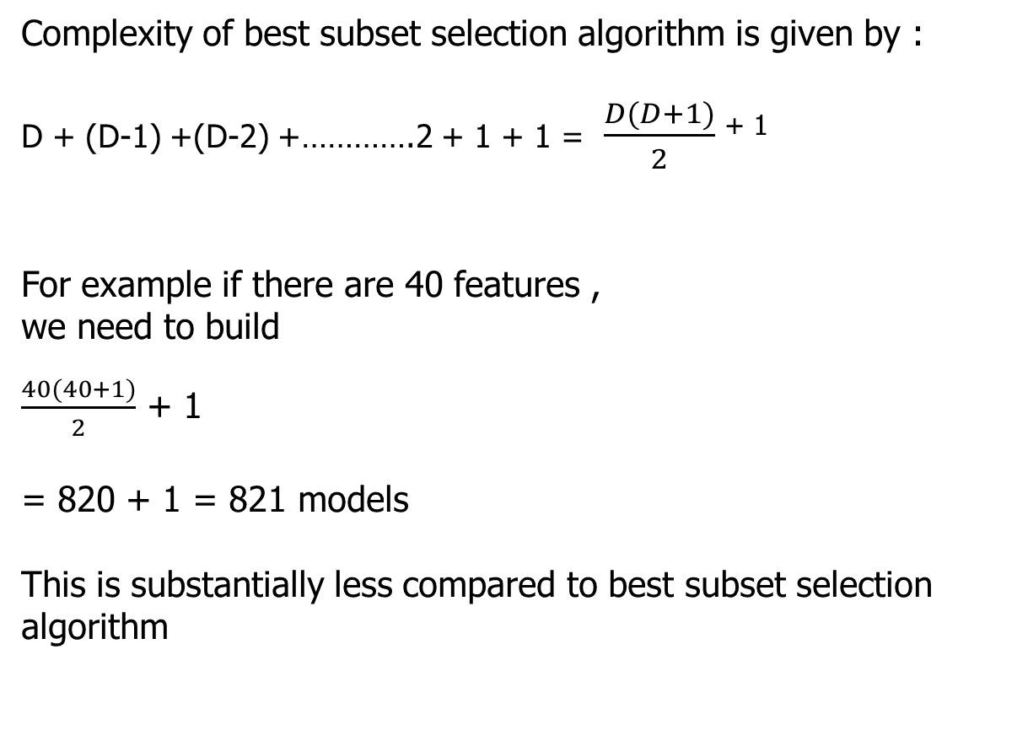
Backward stepwise Selection computations
Complexity of best subset selection algorithm is given by :
D + (D-1) +(D-2) +………….2 + 1 + 1 = $\frac{D(D+1)}{2}$ ⁺ ¹
For example if there are 40 features ,
we need to build
$\frac{40(40+1)}{2}$ + 1
= 820 + 1 = 821‬ models
This is substantially less compared to best subset selection algorithm

Slide 55
Backward stepwise Selection
Training Dataset – 2/3rd of Data Set, Testing Dataset – 1/3rd of Data Set
1. Let M_{D} denote the full model, which contains all p predictors.
2. For k = D, D − 1, . . . , 1:
(a) Consider all k models that contain all but one of the predictors in M_{k}, for a total of k − 1 predictors.
(b) Choose the best among these k models, and call it M_{k−1}. Here
best is defined as having smallest RSS on training dataset (or highest R²).
3. Select a single best model from among M₀, M₁. . . ,M_{D} having smallest RSS on testing error (or equivalently largest R²).

Slide 56
Feature selection Methods Summary
Unsupervised/Filter Method
Supervised/Wrapper based)
Ex: forward/backward selection
Univariate(with each independent and dependent)
Pearson correlation
Chi-square
Etc
Multivariate – consider all features
Lasso regression (weights of features)

Slide 57
References
https://www.youtube.com/watch?v=ie-MYQp1Nic
https://sixsigmastudyguide.com/f-distribution-f-statistic-f-test/
https://statisticsbyjim.com/regression/interpret-f-test-overall-significance-regression/
https://www.newgenapps.com/blog/business-applications-uses-regression-analysis-advantages/
https://www.machinelearningplus.com/machine-learning/feature-selection/

Slide 58
Thank You
References
23 April 2020

